Slide 1
BIA 652 Final Project: Will a bank give you a loan?
By Minal Chandra, Suyash Jawadekar, Kanish Shah, and Elina Tuder

Slide 2




Our Team
Minal Chandra
Kanish Shah
Suyash Jawadekar
Elina Tuder

Slide 3

Why is this important?
Applicants applying for bank loans should know what factors are important in predicting whether they will be approved for a loan
Banks should be careful to not give too many loans, as well as make sure they are giving out loans to people who are capable of paying them back
Notes:
Minal

Slide 4
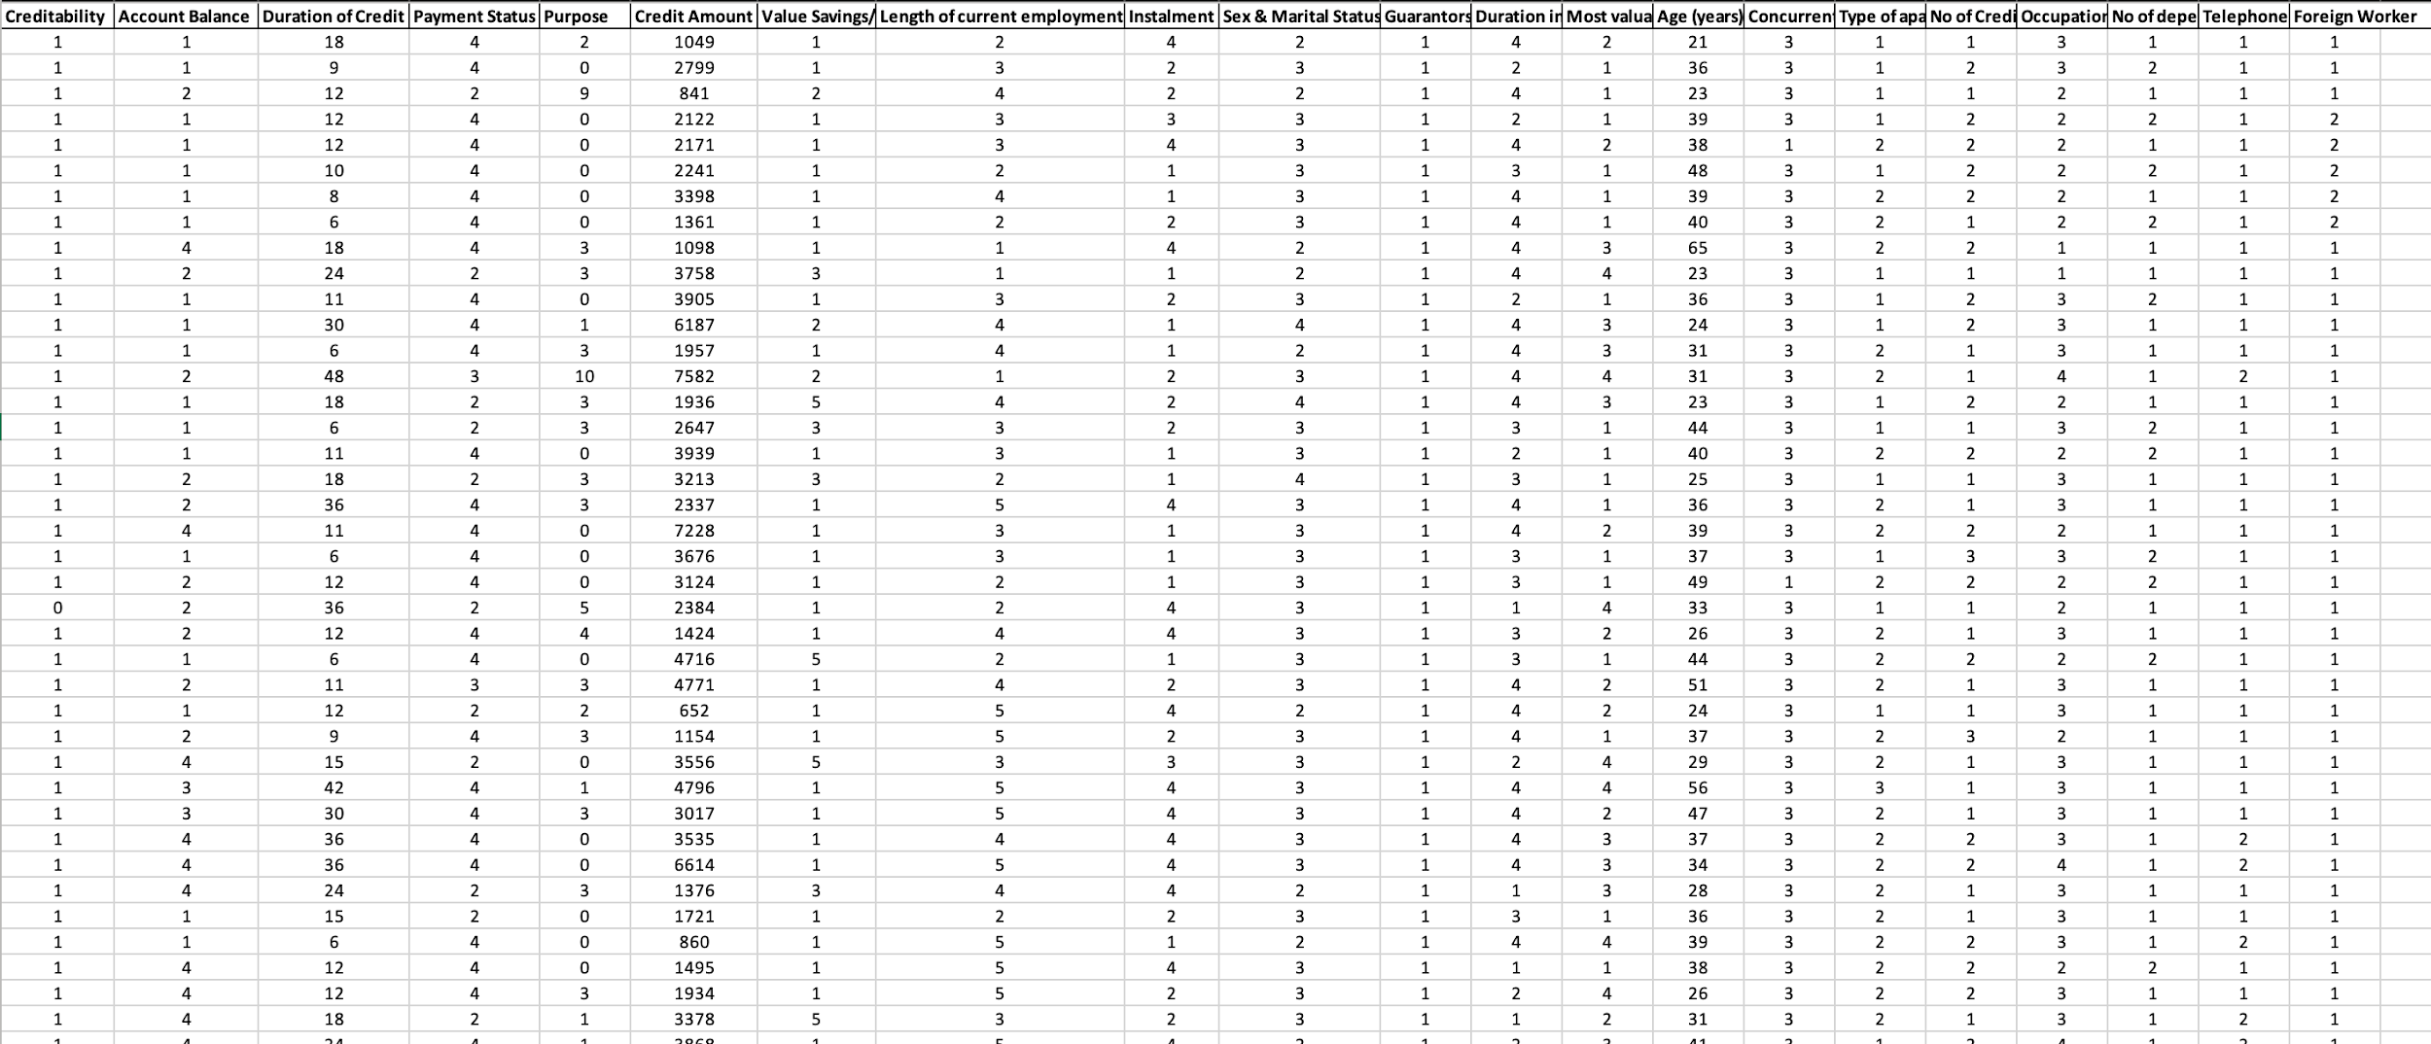
Data
Notes:
Minal

Slide 5
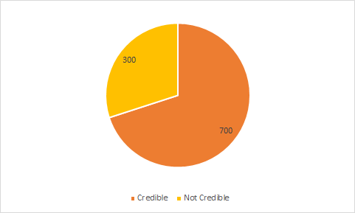
Original Data: Distribution of Creditability
Notes:
Minal

Slide 6

Variables
The dependent variable, “creditability” is a binary variable as the only option for whether a bank gives out a loan is yes (1) or no (0)
This variable determines whether a person is credible or not
If the person is credible (1) then they get a loan
If the person is not credible (0) then they don’t get a loan
Independent variables:
Account Balance
Duration of Credit (month)
Payment Status of Previous Credit
Purpose
Credit Amount
Value Savings/ Stocks
Length of current employment
Type of apartment
No of Credits at this Bank
Occupation
No of dependents
Telephone
Foreign Worker
Installment per cent
Sex & marital status
Guarantors
Duration in current address
Most valuable available asset
Age (years)
Concurrent credits
Notes:
Minal

Slide 7
Visualization of Outliers
There are three continuous variables: duration of credit (in months), credit amount (in tens), and age (in years)
The outliers were found of these variables using proc univariate and were removed

Slide 8
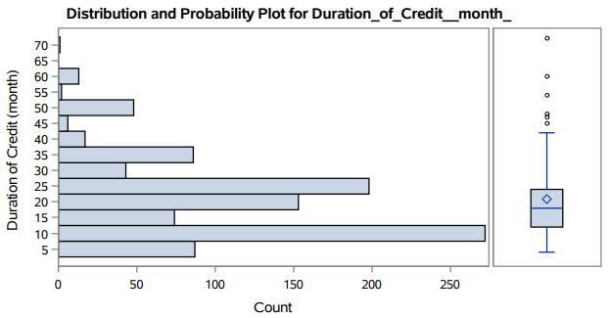
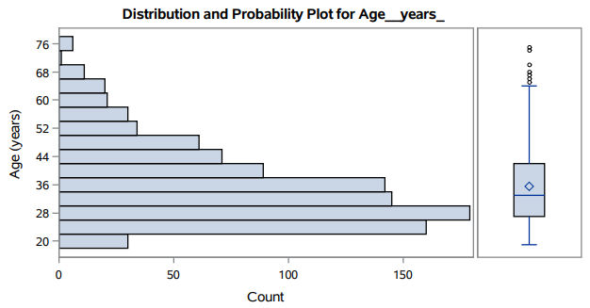
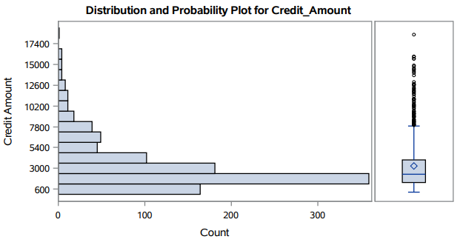
Visualization of Outliers Cont.

Slide 9
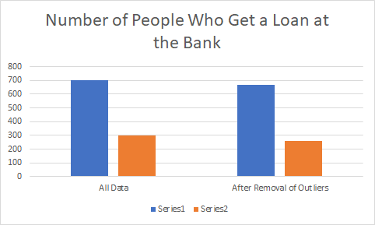
Distribution of Creditability
Credible
Not Credible
Notes:
Elina

Slide 10
What regression method will we use?
Logistic regression!
Our dependent variable (creditability) is a binary variable
Logistic regression can show us the relationship between between the numerical and categorical independent variables and the binary dependent variable
Notes:
Elina

Slide 11
Are our independent variables correlated?
Used the proc corr procedure in SAS
Created a matrix to see the correlation coefficient values between each pair of independent variables
No pair of the variables had r > 0.50
None of the variables were highly correlated
Ran proc reg with VIF to check for multicollinearity
All VIF values < 2
No independent variables were multicollinear
Notes:
Elina

Slide 12
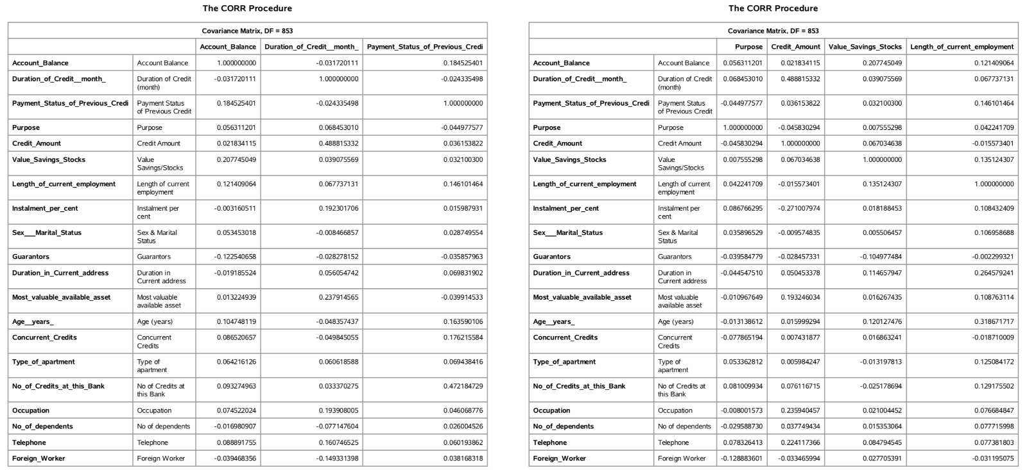
Correlation Matrix
Notes:
Elina

Slide 13
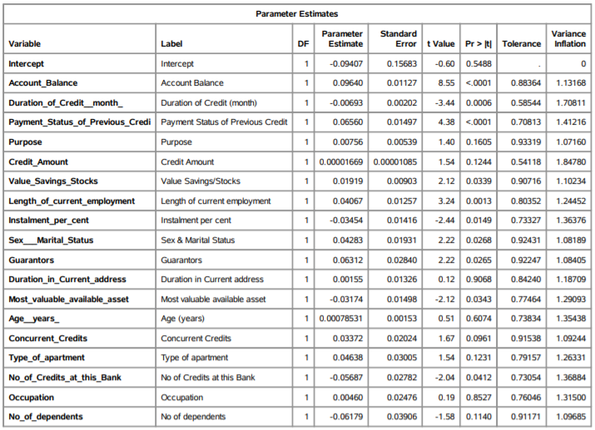
Looking at VIF values for multicollinearity

Slide 14
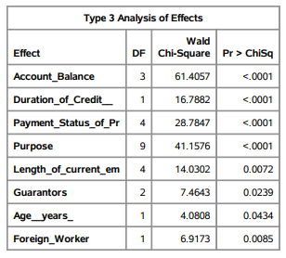
Logistic Regression with Stepwise Selection
Selection method identified 8 variables as being the best predictors for successfully getting a loan
Notes:
Yash

Slide 15
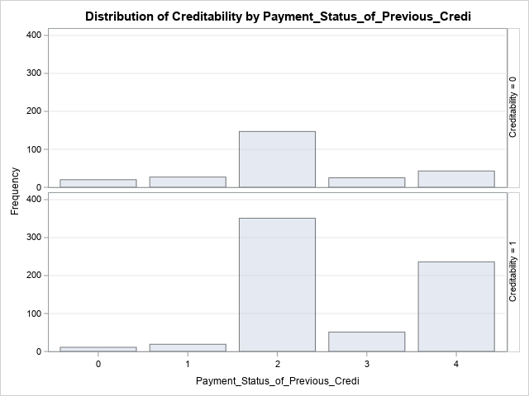
People who have not made payments towards their previous loans are more likely to not receive a loan.
Notes:
Yash

Slide 16
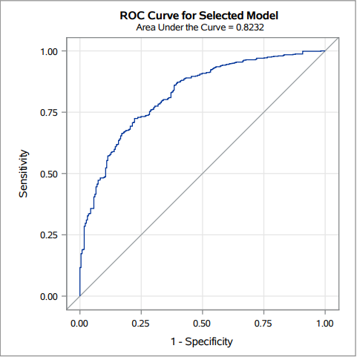
ROC Curve
From the ROC Curve on the right, our accuracy for the model was identified as 82.32%
Notes:
Sensitivity measures how many cases the model accurately predicted - how many people were actually given a loan (true positive)
Specificity measures how many cases the model incorrectly predicted - the model said someone was given a loan but in reality they were not (false positive)

Slide 17
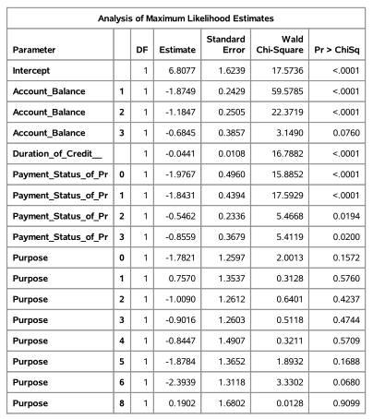
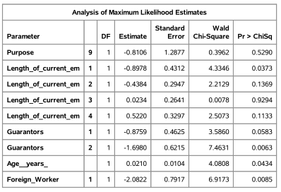
Significant variables with estimate parameters

Slide 18

Probability of successfully getting a loan
Odds =
e^(6.8077 - (1.8749*Account_Balance1) - (1.1847*Account_Balance2) - (0.6845*Account_Balance2) - (0.0441*Duration_of_credit) - (1.9767*Payment_Status_of_Pr0) - (1.8431*Payment_Status_of_Pr1) - (0.5462*Payment_Status_of_Pr2) - (0.8559*Payment_Status_of_Pr3) - (1.7821*Purpose0) + (0.7570*Purpose1) - (1.0090*Purpose2) - (0.9016*Purpose3) - (0.8447*Purpose4) - (1.8784*Purpose5) - (2.3939*Purpose6) + (0.1902*Purpose8) - (0.8106*Purpose9) - (0.8978*Length_of_current_em1) - (0.4384*Length_of_current_em2) + (0.0234*Length_of_current_em3) + (0.5220*Length_of_current_em4) - (0.8759*Guarantors1) - (1.6980*Guarantors2) + (0.0210*Age___years_) - (2.0822*Foreign_Worker1)
The Probability of a person successfully getting a loan from the bank can be computed by the equation below.
Notes:
Kanish

Slide 19
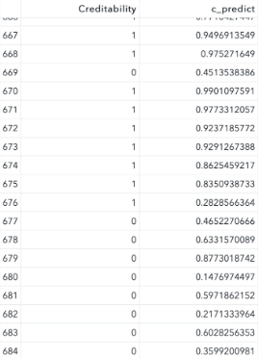
Conclusion
If c_predict > 0.50 the person should get a loan, if c_predict < 0.50 the person should not get a loan
Our model accurately predicts whether a person will get a loan or not 82.32% of the time
Our model identified 8 out of 20 independent variables as the most important in predicting the probability of whether someone will get a loan
Notes:
Kanish

Slide 20
Future Scope
In the future, we could apply some other classification models such as Random Forests, SVM, Discriminant Analysis and Neural Network that can help predict the probability of successfully getting a bank loan at a higher accuracy compared to the Logistic Regression model.
Notes:
Kanish

Slide 21
Thank You

